Slide 1

Strategic Insights and Performance Overview

Slide 2
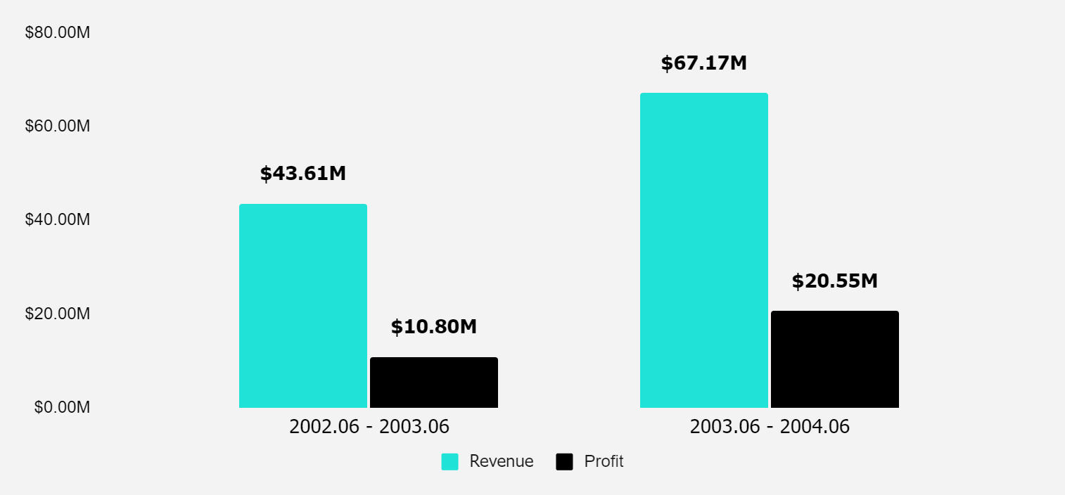
The pricing changes we made in july led to significant benefits in both profit and revenue.
REVENUE AND PROFIT
Revenue increased by 54%
Profit increased by 90.27%

Slide 3
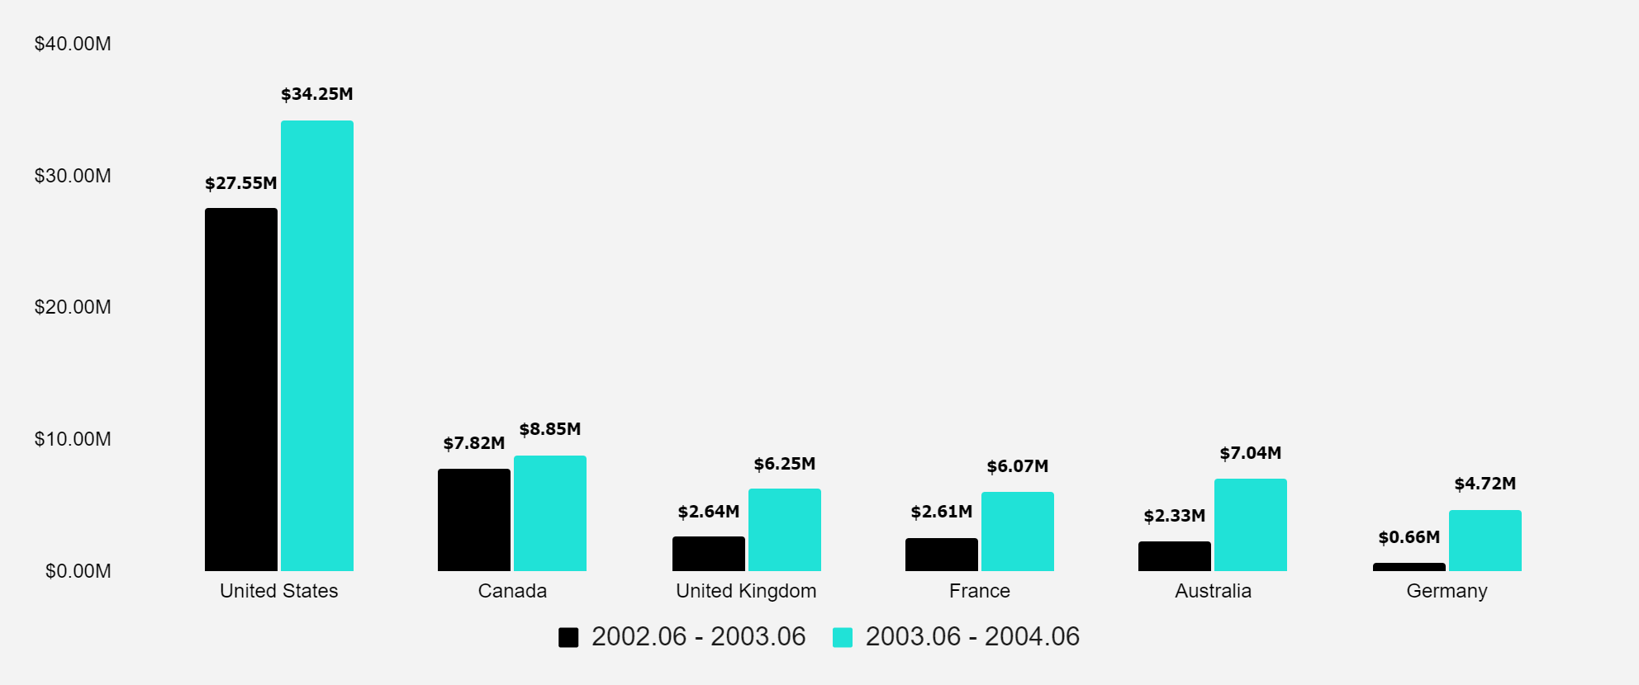
International revenue surge: Capitalizing on global markets
REVENUE BY COUNTRY
Revenue in our main market is growing, with a 24.31% increase this year.
We are experiencing significant growth in previously smaller markets, with our revenue increasing from $8.24 million to $24.08 million.

Slide 4
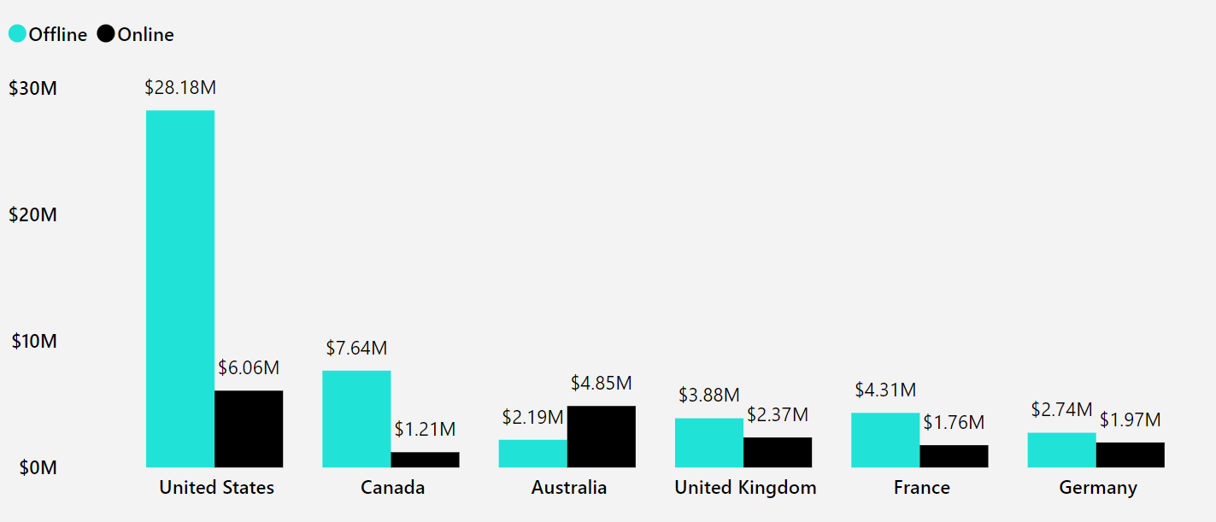
International revenue surge: Capitalizing on global markets
REVENUE BY COUNTRY

Slide 5
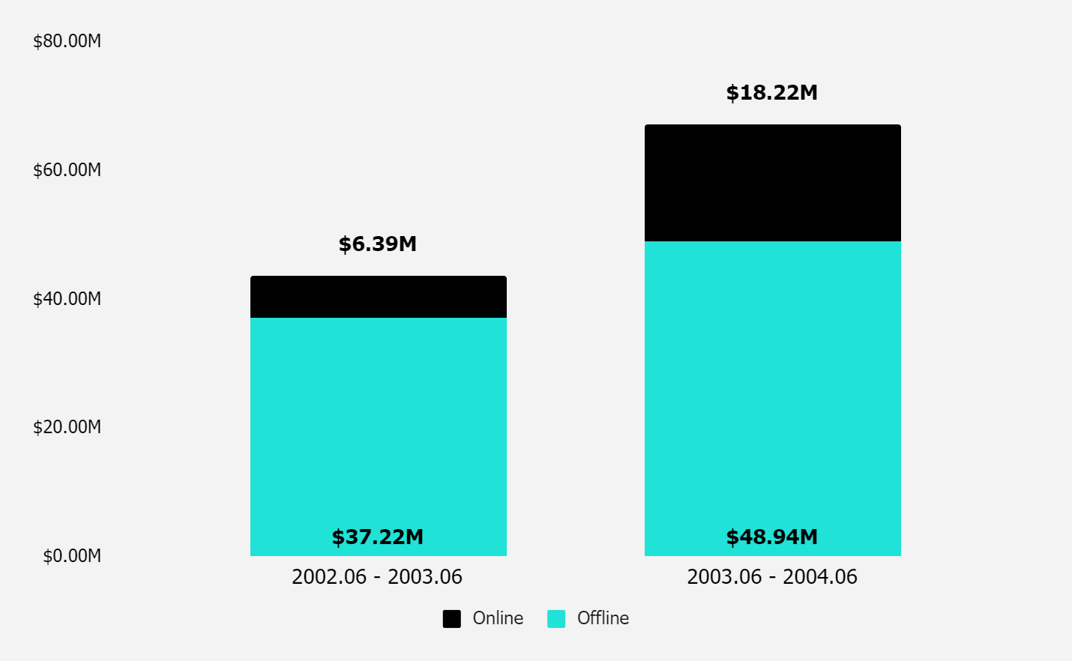
Online shopping continues to grow at an incredible pace, and we're seizing this opportunity to expand our reach and better serve our customers.
ONLINE AND WHOLESALE REVENUE
Revenue from online sales has nearly tripled.

Slide 6
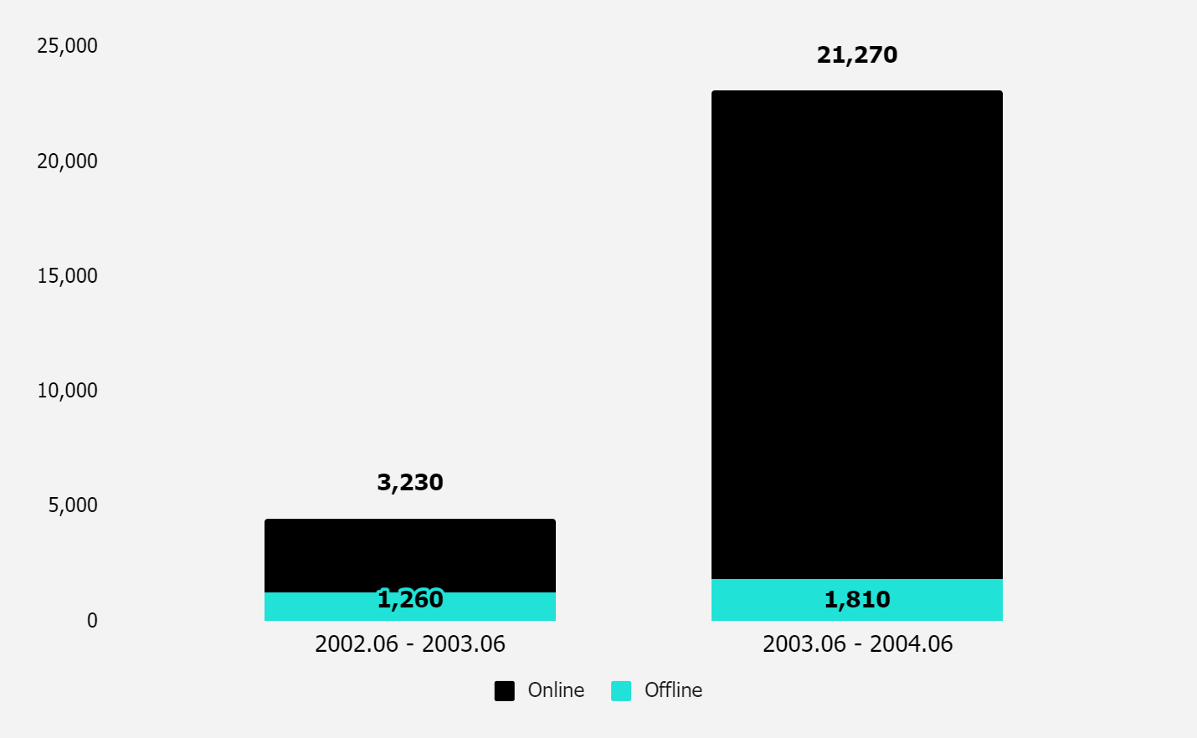
Online channels lead the charge in sales growth
ONLINE AND WHOLESALE ORDERS

Slide 7
Given that global e-commerce sales have skyrocketed it's crucial that we continue to invest in our online platform to capture more of this growing market.
Canada's slower growth requires further analysis to understand and address the underlying factors.
Moving forward, we must prioritize promoting online sales, optimizing pricing, and expanding our global reach to maintain this momentum and capitalize on emerging opportunities.

